Slide 1
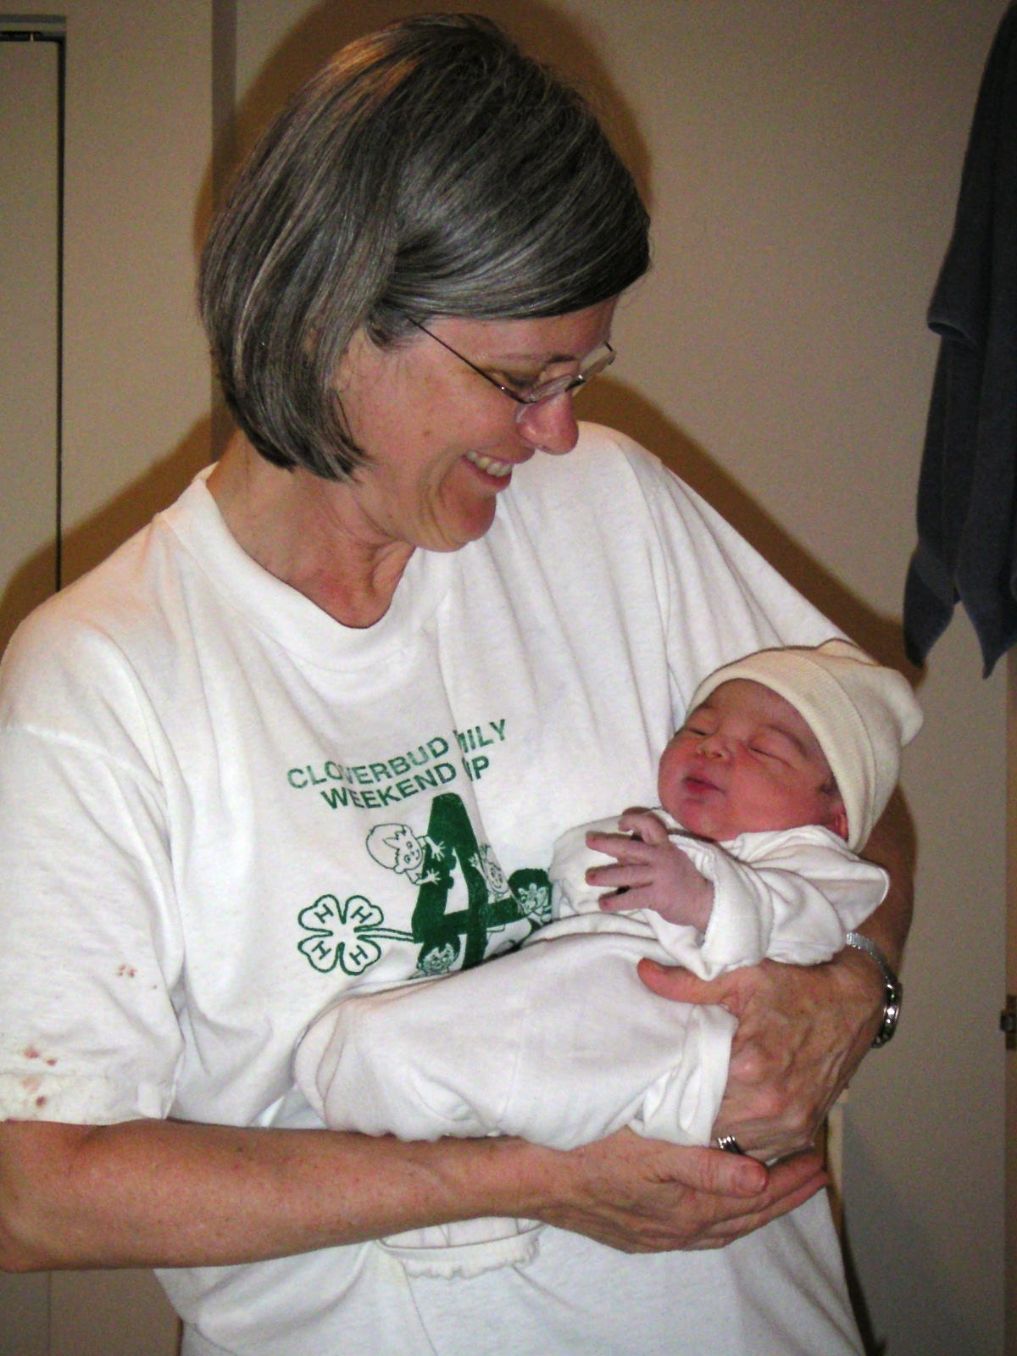
Certified Professional Midwives Our Past, Present, and Future in Virginia
Commonwealth Midwives Alliance

Slide 2
Direct-Entry Midwifery
Definition:
A general term used to describe a midwife who has received her training without first becoming a nurse.
Training can include formal educational programs and usually incorporates apprenticeship training.
“Lay” midwives and “Granny” midwives were direct-entry midwives

Slide 3
Direct-Entry Midwifery
Virginia History:
Community based/trained “registered” or “permitted” midwives
Shift to hospitals for women of means (~50’s-60’s)
Challenged by medical community
Segregation ensures survival through “granny midwives”

Slide 4
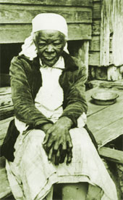
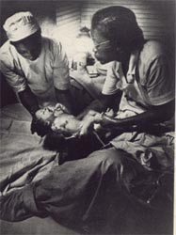
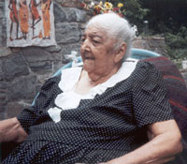
"Old Sibby" a slave midwife in rural Georgia. Photographer unknown: Georgia Historical Archives
African American Midwives
Virginia Midwives:
Orlean Puckett (1844-1939, Carroll County) The Life of a Mountain Midwife
Claudine Curry Smith (1918-, Northern Neck) My Bag Was Always Packed
Maude Callan, one of the first formally educated midwives in S.C. photographer W. Eugene Smith Life magazine
Alabama Grand Midwife Margaret Smith, Age 98

Slide 5
Direct-Entry Midwifery
History (cont):
“Permitted” to practice through the Dept of Health.
Little formal training; minimal standards; See “Midwife Manual” in C. Smith’s book.
Great outcomes: 2 complaints filed from 1918-1976.
In 1977, the GA passed legislation that limited the practice of non-nurse midwifery to those who were permitted prior to Jan 1, 1977 (no new permits issued after that time).
This is about the same time that Certified Nurse Midwives were first licensed in Virginia.

Slide 6
Certified Professional Midwives
MANA (Midwives Alliance of North America) 1982
Recognized the need for the development of a direct-entry midwifery credential suitable for licensure
NARM (North American Registry of Midwives)
Developed the Certified Professional Midwife (CPM) credential www.narm.org 1987
CPM training includes specialized, competency-based education programs, risk assessment training, and requires out-of-hospital clinical experience

Slide 7
Certified Professional Midwife
Validates knowledge, skills and experience
Is a competency-based evaluation process
Over 1300 contact hours
Average 3 year program
Incorporates two examinations
NARM Skills Assessment
NARM Written Examination
Meets rigorous credentialing standards (accredited by NCCA-National Commission for Certifying Agencies, NOCA-National Organization for Competency Assurance)
Sets a standard for public safety
Is legally defensible

Slide 8
Legislative History in Virginia
1998-1999 – The Joint Commission on Health Care (JCHC) studied “the advisability of legalizing the practice of midwifery in the Commonwealth.”
1999 – The JCHC recommended the legalization of the practice of direct-entry midwifery by individuals who meet the competency requirements of the North American Registry of Midwives (Certified Professional Midwives).
2000- 2002 - Legislative efforts continued to further determine how to regulate direct-entry midwives.

Slide 9
Legislative History (cont.)
2003 - HB 1961 repealed the law requiring that non-nurse midwives be registered and permitted by the Department of Health.
2004 - HB 581, a CPM licensing bill, passed the House by a vote of 91-9.
2005 - HB 2038 and SB 1259 passed the General Assembly with a wide majority and were signed into law by Governor Warner (effective 7/05).

Slide 10
New Law—Regulations
The Board of Medicine shall adopt regulations, with advice from the Advisory Board on Midwifery established in the bill.
The regulations shall
address the requirements for licensure to practice midwifery
ensure independent practice
The regulations shall not
require any agreement, written or otherwise, with another health care professional or
require the assessment of a woman who is seeking midwifery services by another health care professional

Slide 11
New Law-Regulations (cont.)
Licensed Midwives must disclose to clients certain background information, including their training and experience, written protocol for medical emergencies, malpractice or liability insurance coverage, and procedures to file complaints.
The statute provides immunity to physicians, nurses, pre-hospital emergency personnel or health care institutions for acts resulting from the administration of services by any Licensed Midwife.

Slide 12
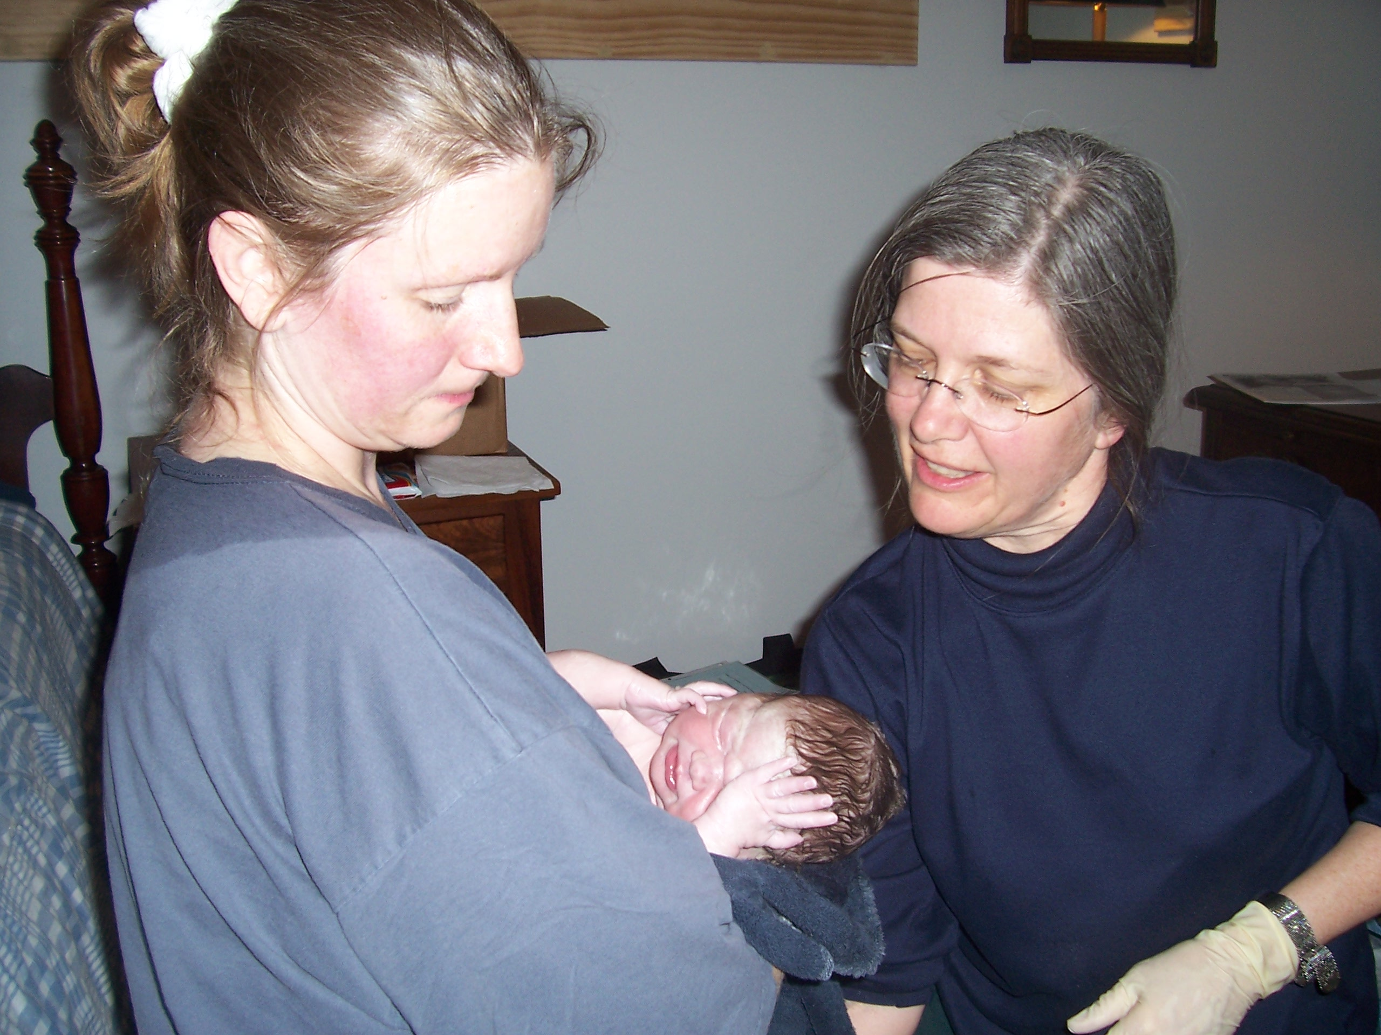
Why choose a midwife?
Women want:
Respectful Treatment
Appropriate Monitoring
Confidence in Their Bodies
Natural Techniques for Comfort
Plenty of Information
A Care Provider Who Stays With Them

Slide 13
What is the Midwives Model of Care?
The Midwives Model of Care is based on the fact that pregnancy and birth are normal life processes.
The Midwives Model of Care includes:
Monitoring the physical, psychological, and social well-being of the mother throughout the childbearing cycle
Providing the mother with individualized education, counseling, and prenatal care, continuous hands-on assistance during labor and delivery, and postpartum support
Minimizing technological interventions
Identifying and referring women who require obstetrical attention
The application of this woman-centered model of care has been proven to reduce the incidence of birth injury, trauma, and cesarean section.
Copyright (c) 1996-2005, Midwifery Task Force, Inc., All Rights Reserved.

Slide 14
Midwives Model of Care
“..pregnancy and birth are normal life processes.”
“Birth is normal” rather than, “What might go wrong?”
Evidence-based; studies have shown that most births are uncomplicated
Provider-induced fear can lead to stress-induced complications

Slide 15
Midwives Model of Care
“Monitoring the physical, psychological, and social well-being of the mother throughout the childbearing cycle”
Standard lab tests
Involve mother in self-care
Continuity of care
30-60 minute average prenatal visit
Balance evidenced-based care with traditional practices (herbs, homeopathy, yoga)

Slide 16
Midwives Model of Care
“Providing the mother with individualized education, counseling, and prenatal care, continuous hands-on assistance during labor and delivery, and postpartum support”
Start to finish labor support
Informed choice includes both the risks and benefits of accepting or avoiding a test, procedure, or drug
Respect for mother’s culture and preferences
Effective breastfeeding support

Slide 17
Midwives Model of Care
“Minimizing technological interventions”
Lower cesarean section rates
Lower epidural rates
Fewer episiotomies, forceps, vacuum extractions
Fewer inductions
Non-intrusive measures for pain relief and labor support

Slide 18
Midwives Model of Care
“Identifying and referring women who require obstetrical attention”
Midwives are trained to recognize signs of complications before they become emergencies.
Optimal outcomes for mothers and babies are achieved when there is trust and respect among providers
Autonomous practice removes liability based obstacles to midwife-physician relationships

Slide 19
Midwives Model of Care
“Giving birth: home can be better than hospital”
"... giving birth at home bears similar risks of intrapartum and neonatal mortality as low-risk birth in hospital, but planned home births are associated with lower rates of medical interventions.”
“... The study participants experienced substantially lower rates of epidurals, episiotomies, forceps deliveries, vacuum extractions, and cesarean sections than women with low risk pregnancies who gave birth in hospital."
BMJ 2005;330 (18 June), doi:10.1136/bmj.330.7505.0-a

Slide 20
Midwives Model of Care
Study Parameters
Over 5000 births
Prospective data
Certified Professional Midwives
Not necessarily well-integrated into the healthcare system in many states
12% transport rate
Ongoing project

Slide 21
Mothers as activists in Virginia
Consumer Organizations:
Virginia Friends of Midwives (VFOM)
Midwifery Options for Mothers (MOM), 501c3
Informed Birth Options of Central Virginia
Motherwise Birth Resources
Harrisonburg Advocates for the MMOC
Families for Natural Living, 501c3
Virginia Birthing Freedom
Birth Matters!

Slide 22
Next Steps
Midwives-PAC
Endorse and support Virginia political candidates who support midwifery and the Midwives Model of Care
Midwifery Foundation - 501c3
Promote midwifery in Virginia by providing scholarships to aspiring midwives
Develop programs that increase awareness and accessibility to the Midwives Model of Care
Coalition building
Certified Nurse Midwives
OB/GYN, Family Practice, Pediatricians
Women’s Organizations
Family-Centered Organizations

Slide 23
Contact Information
Birth Matters! www.birthmattersva.org/
Citizens for Midwifery (CfM) www.cfmidwifery.org
Commonwealth Midwives Alliance www.commonwealthmidwives.org/
Midwives Alliance of North America (MANA) www.mana.org
Midwives-PAC www.midwivespac.org/
North American Registry of Midwives (NARM) www.narm.org
National Association of Certified Professional Midwives (NACPM) www.nacpm.net

